Slide 1

AGRICULTURE MARKET INFORMATION SYSTEM
Presenter name:
Akriti Dhyani-202319018

Slide 2
GOAL & OBJECTIVE
Increase transparency in agricultural markets by providing real-time information on prices, demand, and supply for various crops and commodities.
Contribute to price stability by reducing information asymmetry, enabling stakeholders to make well-informed decisions in response to market dynamics.
Help farmers and traders mitigate risks associated with market fluctuations, enabling them to plan and manage their resources effectively.
Empower farmers in negotiations by providing historical and current market data, giving them leverage in price discussions.

Slide 3

SCOPE:
Functionalities:
Real-time Market Information: Provide users with up-to-date information on market prices, demand and supply dynamics, and relevant trends for selected agricultural commodities.
Historical Data Analysis: Allow users to analyze historical market data to identify patterns, make informed decisions, and strategize for the future.
Out of Scope Functionalities:
Market Predictions:
Predicting future market conditions or prices beyond historical trends is out of scope. The system provides historical data for users to make their own assessments.

Slide 4

Topics covered:
Libraries and modules
Function
Loops(while , for)
If else conditional statement
List

Slide 5
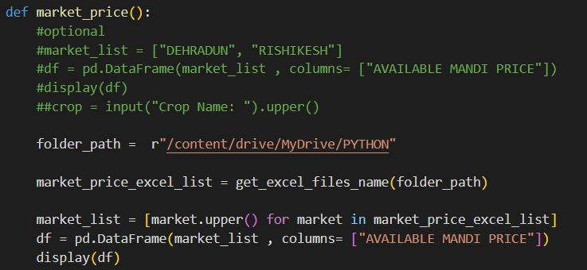
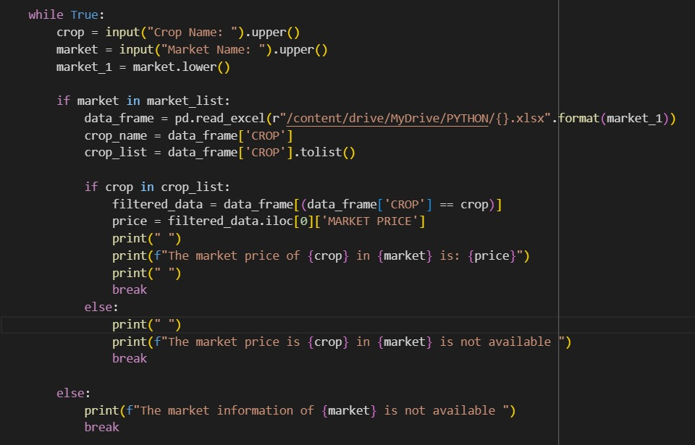
CODE SNIPPETS

Slide 6
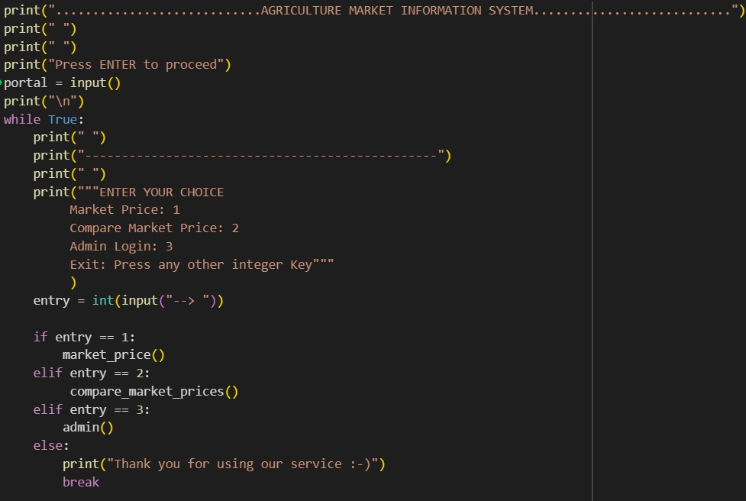
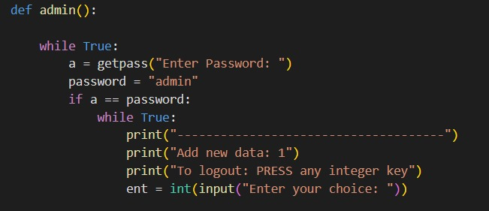
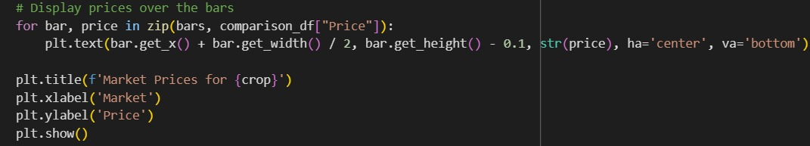

Slide 7
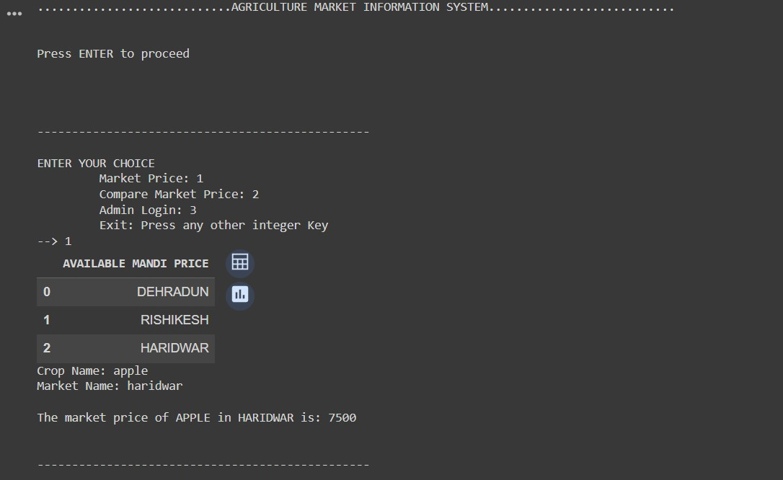
OUTPUTS

Slide 8
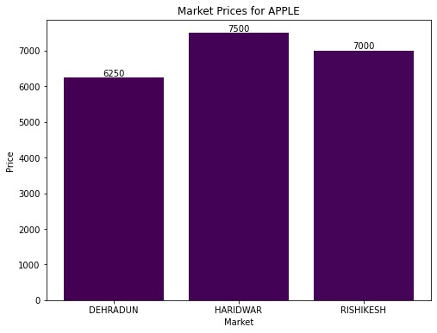
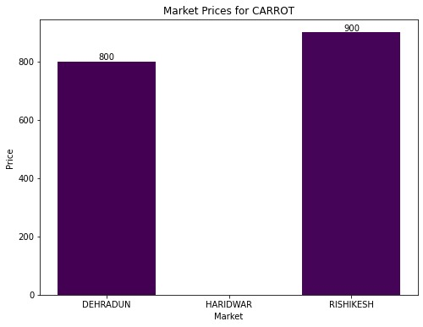

Slide 9
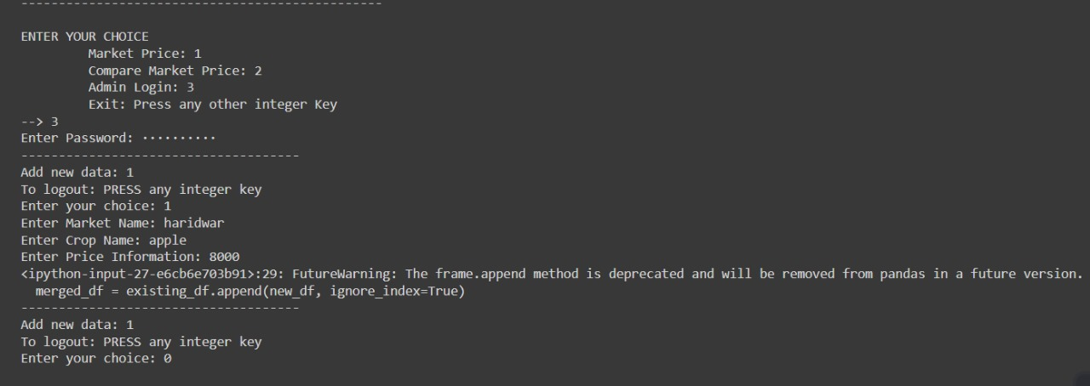

Slide 10
Lessons learned:
Learned using new libraries like matplotlib which helped in visualization of our dataset.
Learned about getpass where the function hides the input while the user is typing, providing a more secure way to handle sensitive information

Slide 11
The successful implementation of an Agriculture Market Information System requires a holistic approach that considers technological, social, and economic factors.
By aligning the project with the needs of the agricultural community, fostering collaboration, and maintaining a commitment to continuous improvement, the AMIS has the potential to positively impact the livelihoods of farmers, enhance market efficiency, and contribute to the sustainable development of the agriculture sector.
Regular updates and adaptations based on feedback and changing conditions will be essential to ensuring the long-term success and relevance of the AMIS.
By providing real-time, accurate, and accessible information to farmers, traders, and other stakeholders, the AMIS can contribute to informed decision-making, risk mitigation, and overall improvement in the agricultural supply chain.
CONCLUSION
&
FUTURE WORK

Slide 12

Thank you

